Slide 1
DATS 6101 – PROJECT ON CHILD CARE INSPECTION
Team number : 6
Team members:
Adina Dingankar 4. Rehapriadarsini Manikandasamy
Ashwin Arun Dixit 5. Yaqian Lin
Deyu Kong

Slide 2





AGENDA
About the Dataset
SMART Questions
EDA
Statistical Testing
Model Building

Slide 3
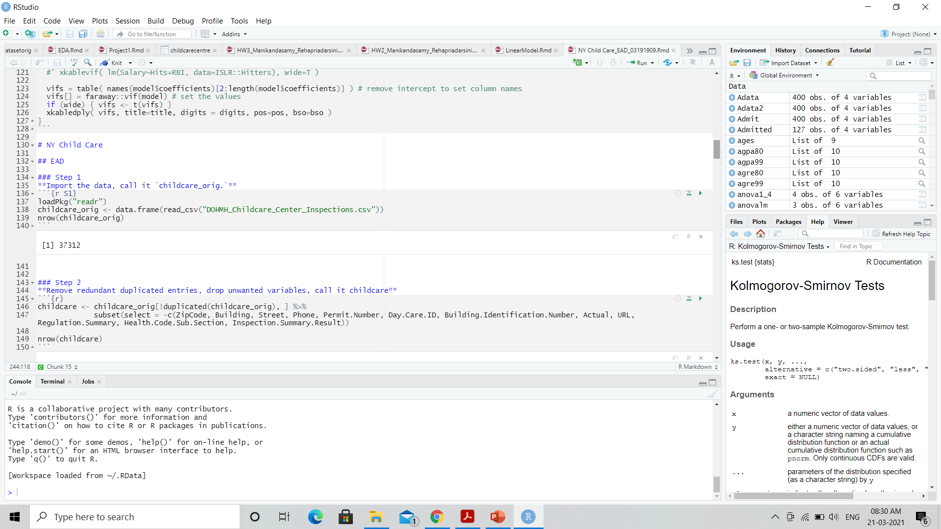
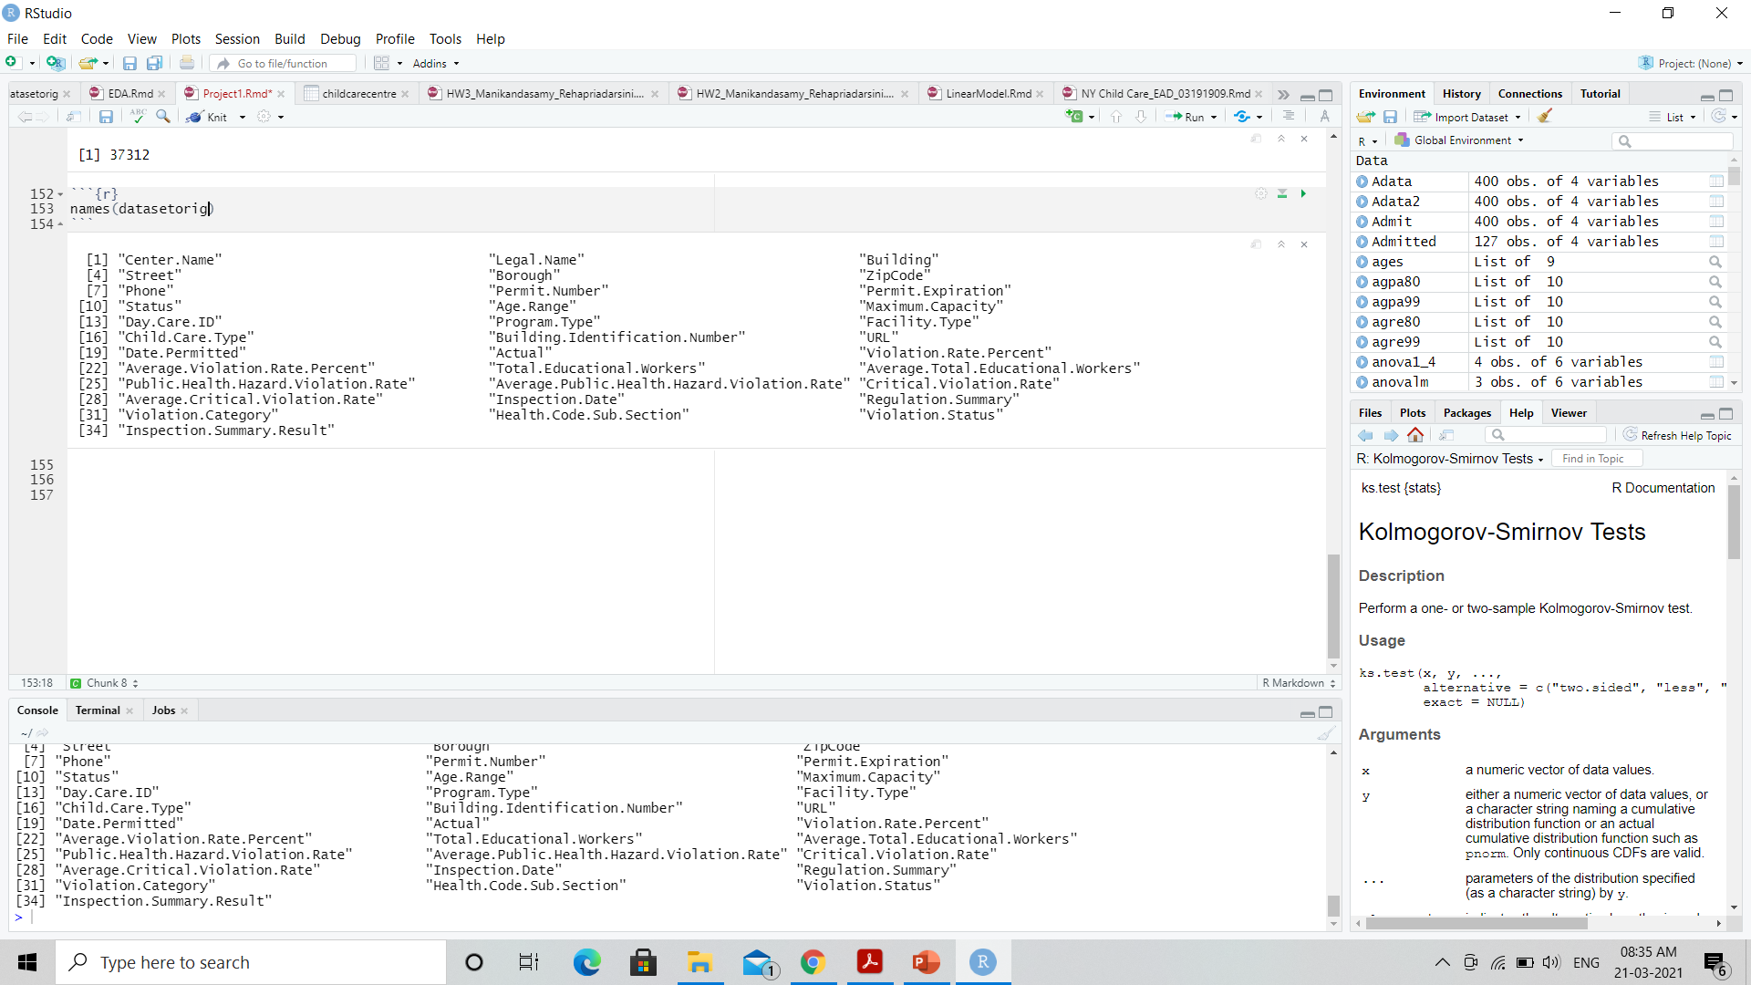
About the Dataset
The Child Care Inspection dataset contains a record of all investigations conducted and any related violations at active, city-regulated, center-based child care programs and summer camps over the years 2018-2021
Source : Department of Health and Mental Hygiene (NYC Open DATA repository)
Number of Observations : 37312 Number of Variables : 34

Slide 4
SMART Questions
To discover the distribution of Centers, Borough and Program Type
What is the percent of violations reported in each category in all the childcare centers?
Which borough has improved over the period (2018-2021)?
SPECIFIC
MEASURABLE
ACHIEVABLE
RELEVANT
TIME - ORIENTED

Slide 5

Exploratory Data Analysis
Image source:
https://www.aiche.org/academy/webinars/applied-statistics-exploratory-data-analysis

Slide 6
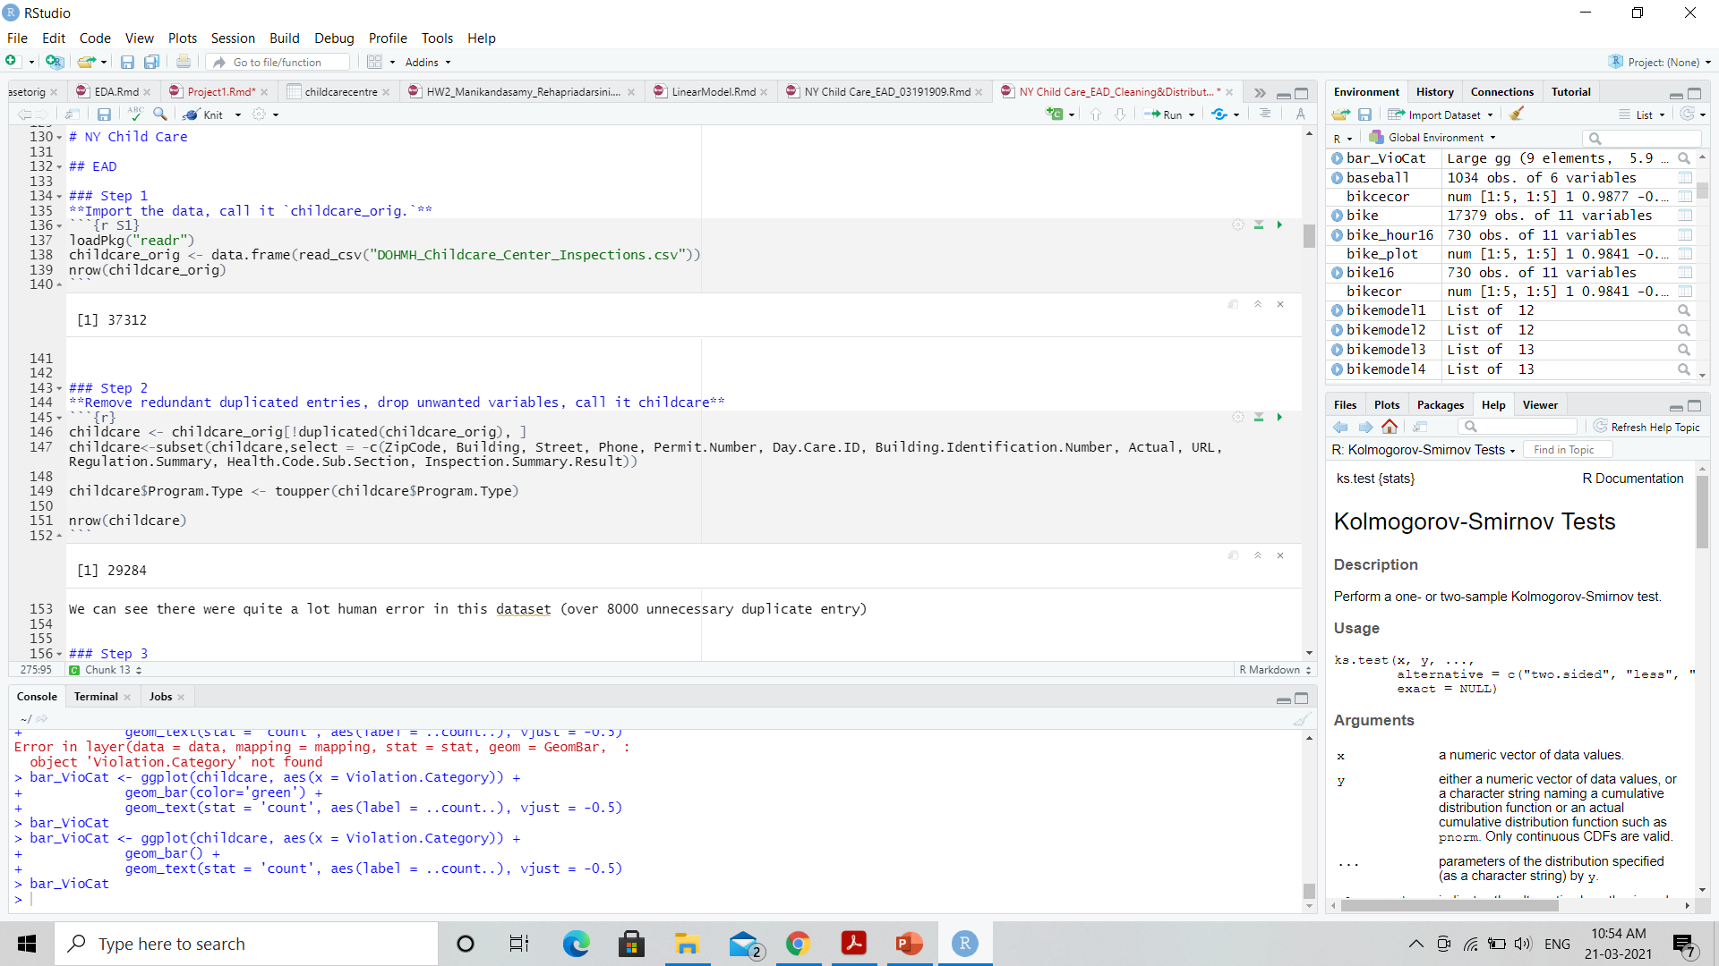
EDA
Removed redundant duplicated entries
Dropped variables which doesn’t make much impact for the analysis

Slide 7
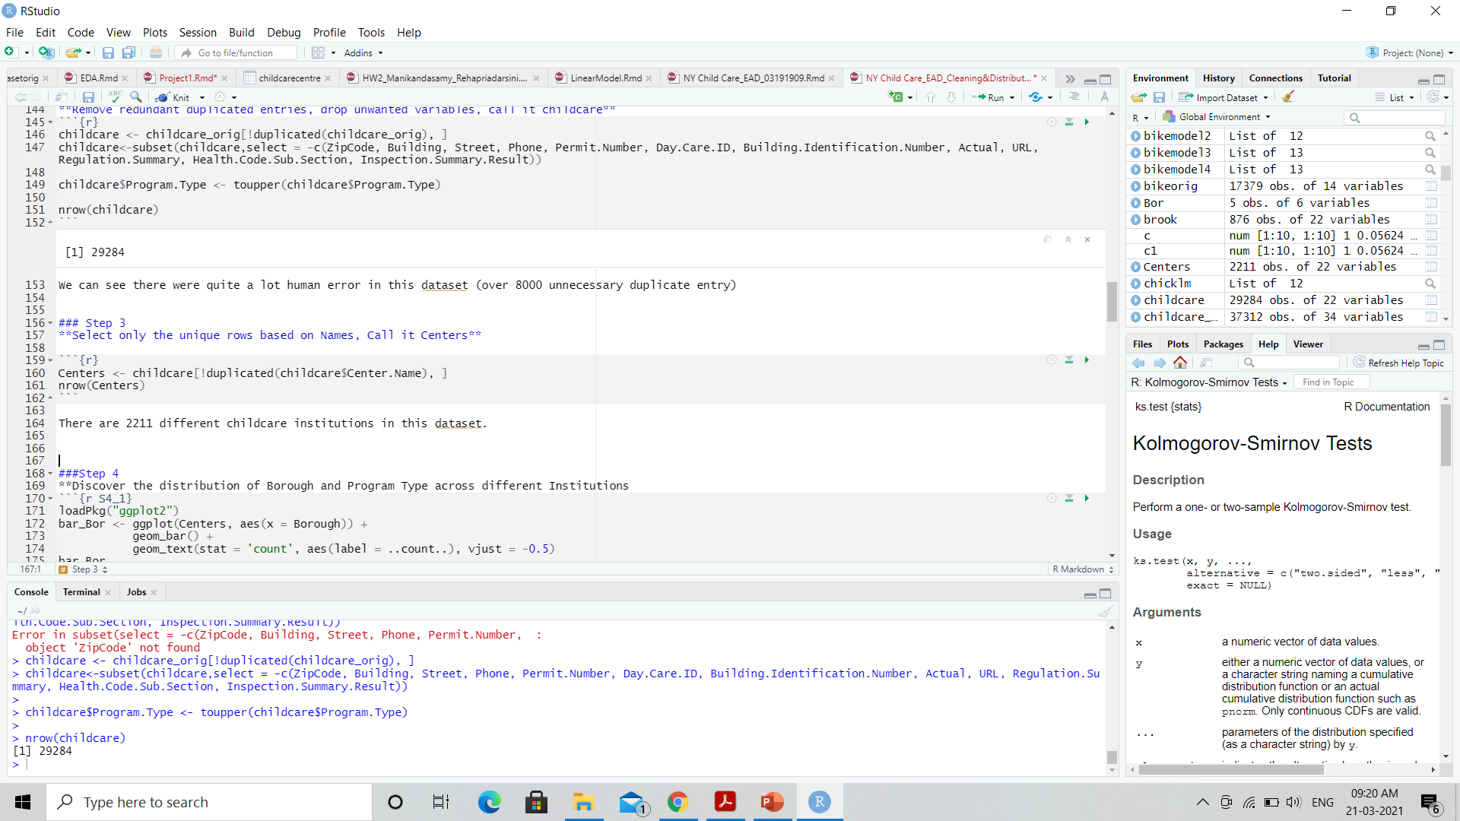
EDA
Selected only the unique rows based on Center Names
Graphs used:
Donut Chart
Bar plot
Histogram
Box plot
Line plot

Slide 8
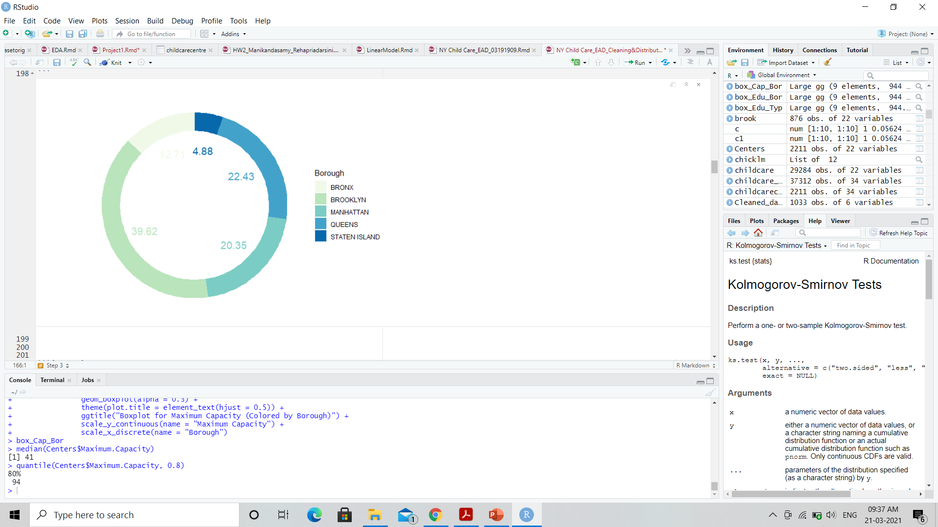
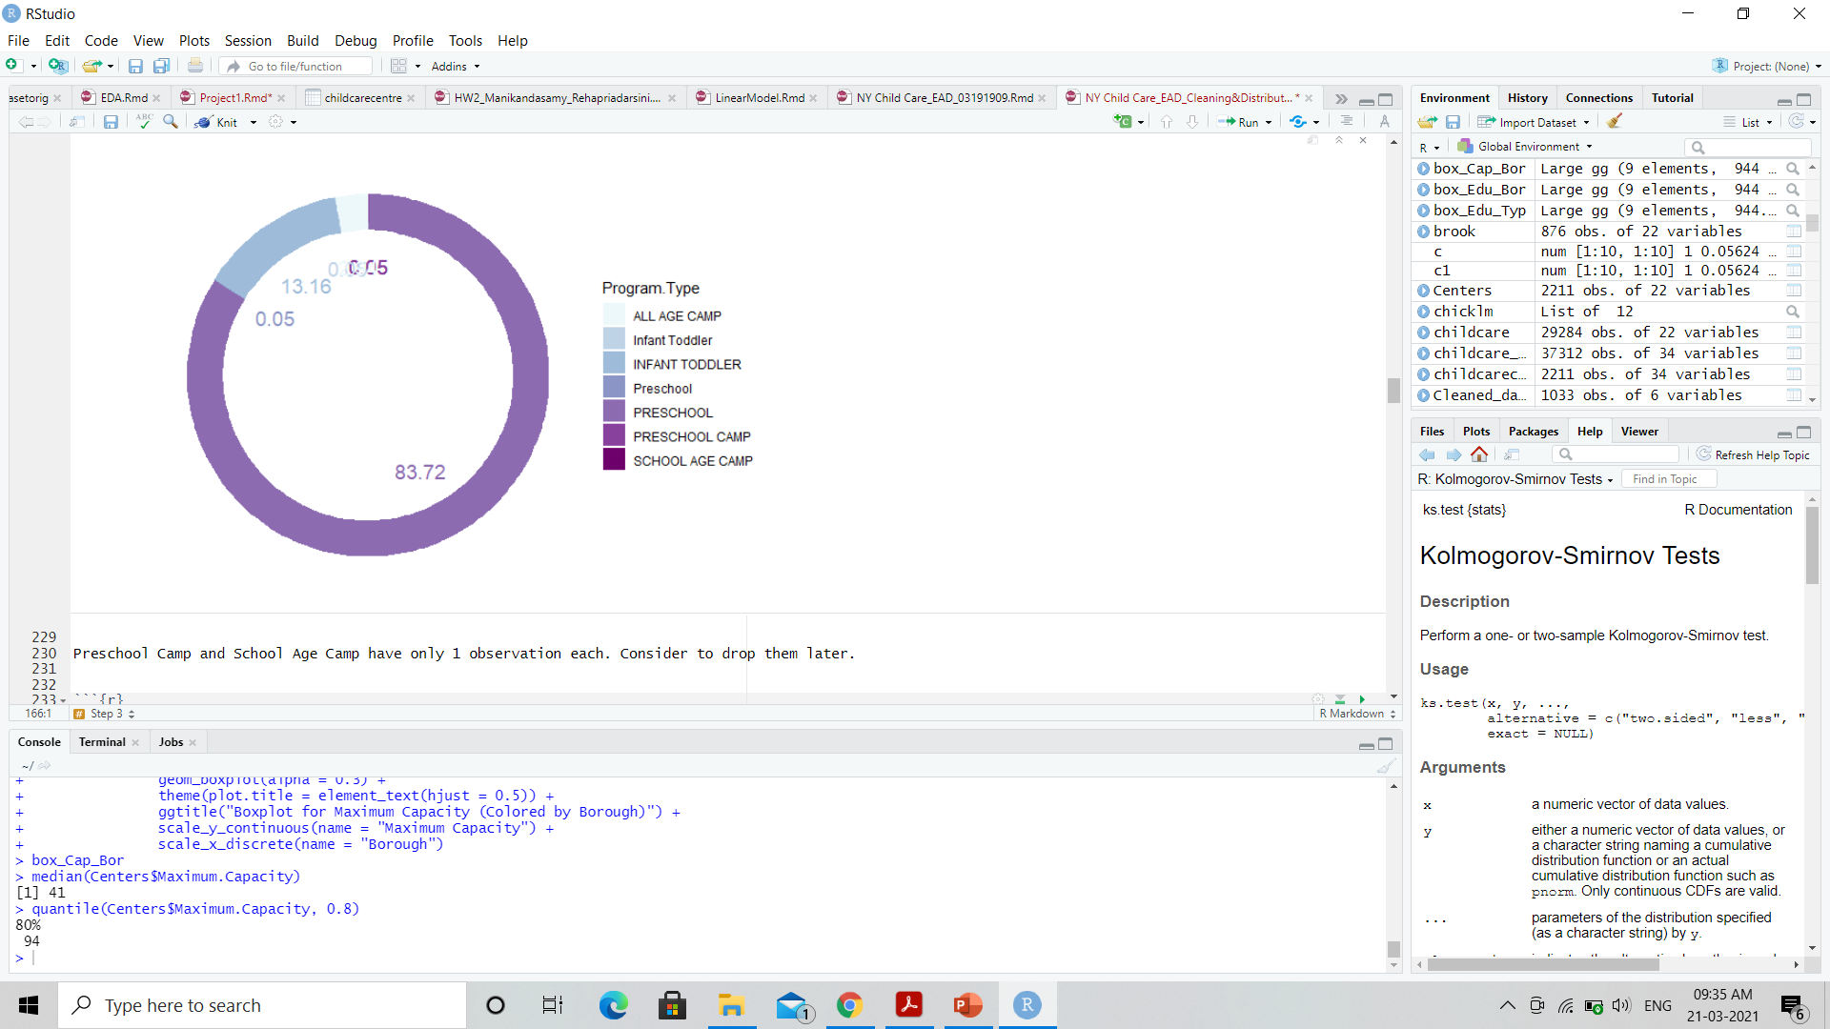
Discover the distribution of Centers, Borough and Program Type
Donut representation of centers and Borough
Donut representation of Centers and Program Type

Slide 9
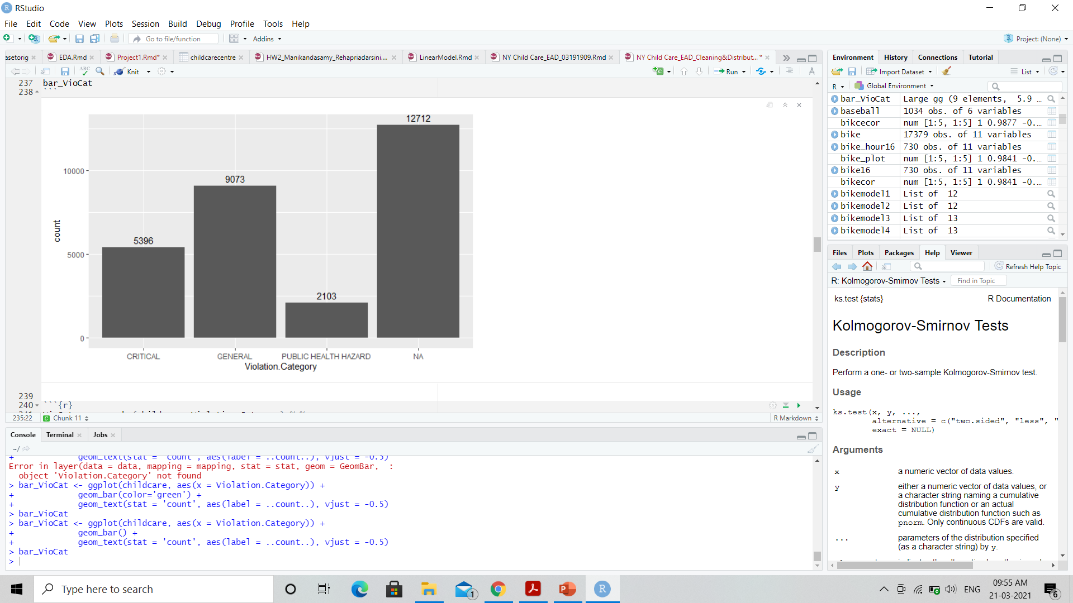
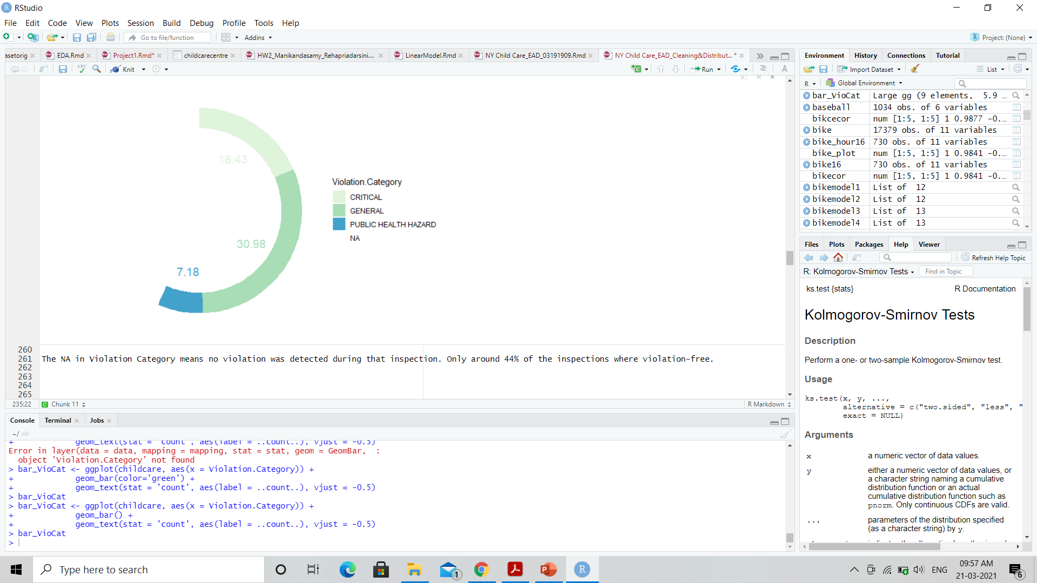
What is the percent of violations reported in each category in all the childcare centers?
Bar plot of number of violations recorded in each category
Donut Representation (in percent)
The NA in Violation Category means no violation was detected during that inspection. Only around 43.41% of the inspections where violation-free

Slide 10
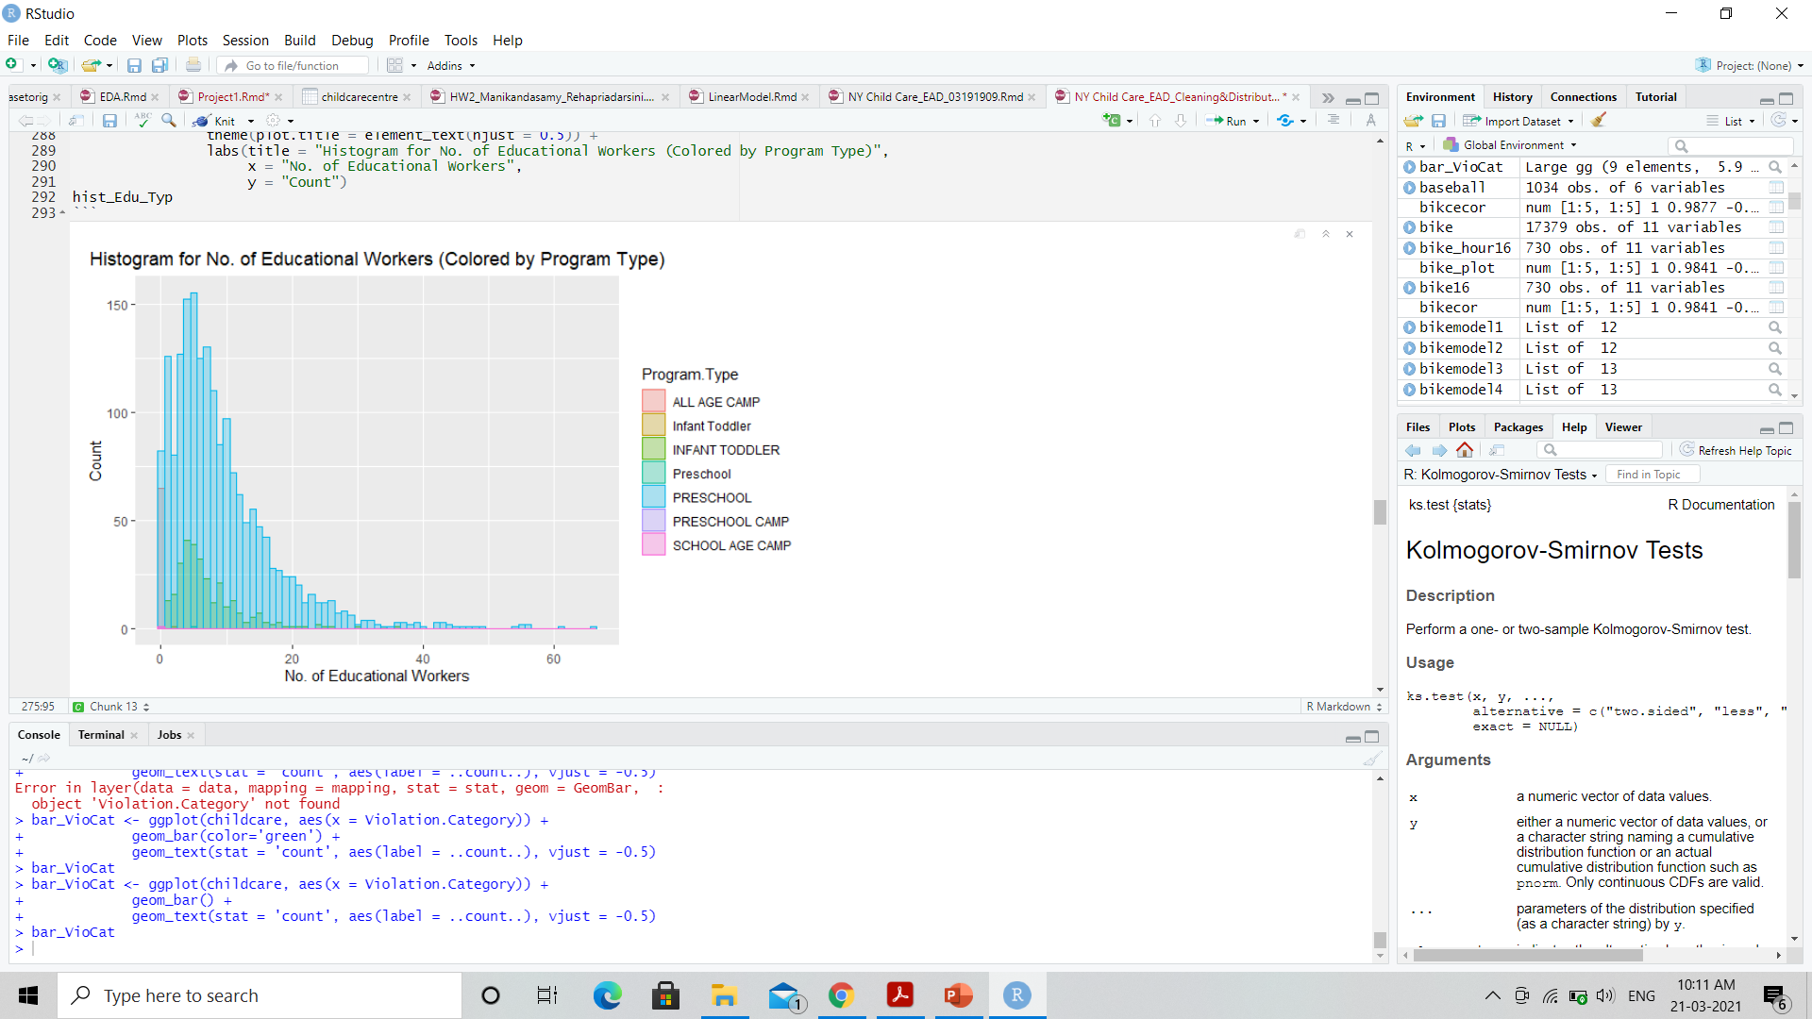
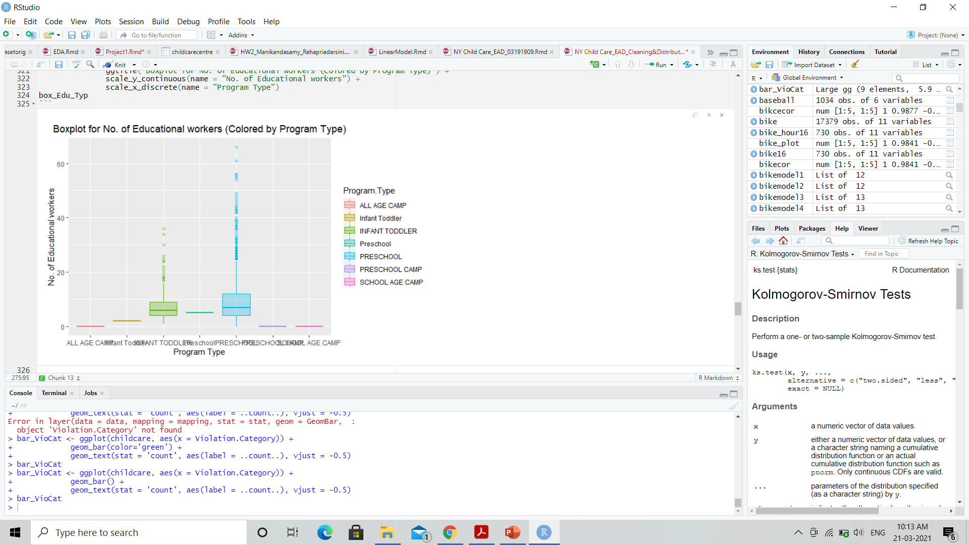
How many educational workers are distributed across various program types?

Slide 11
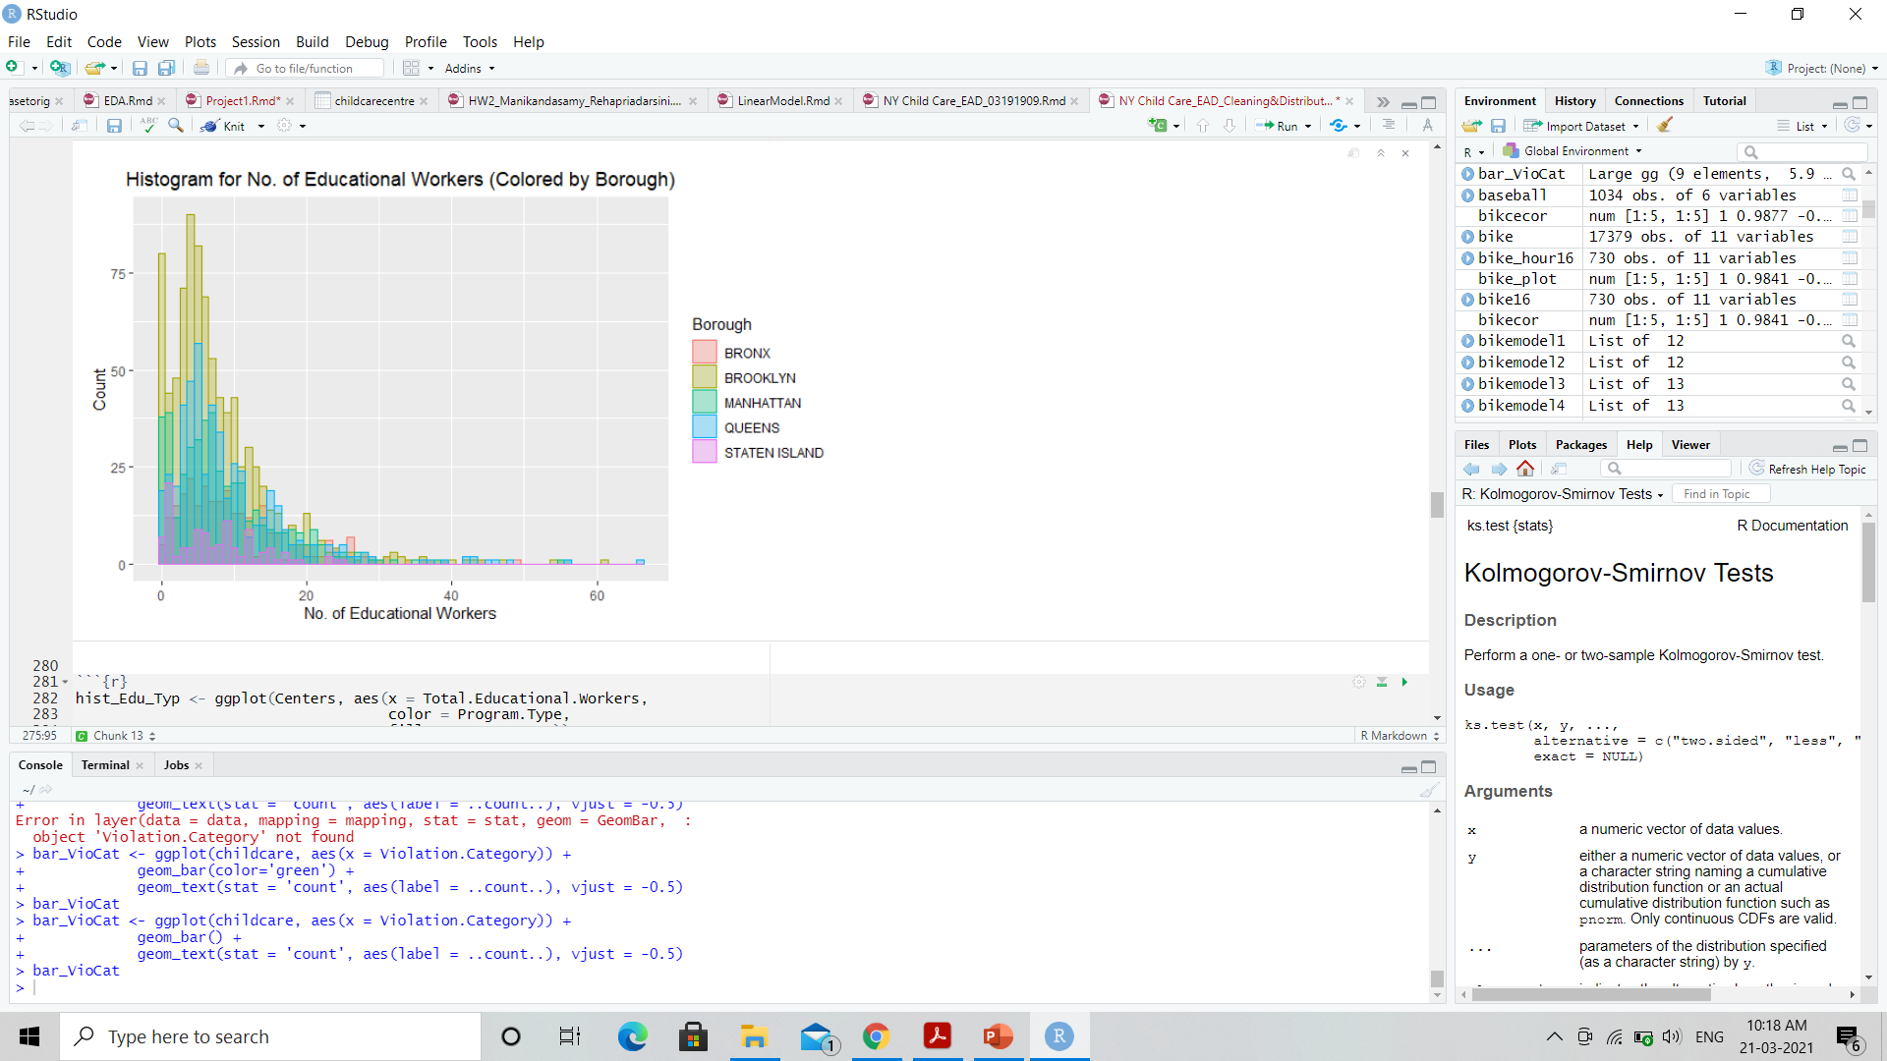
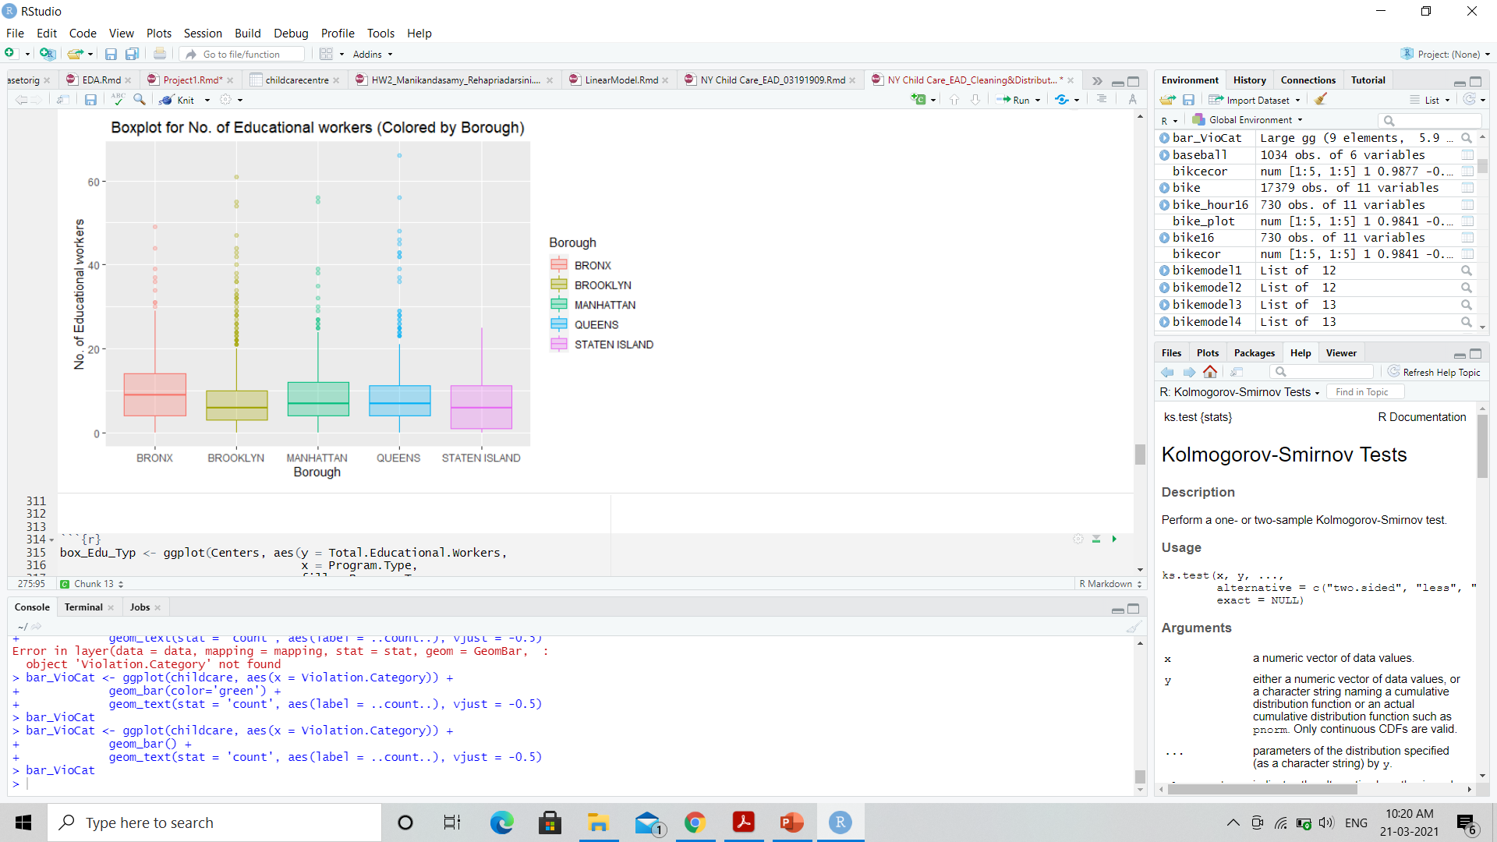
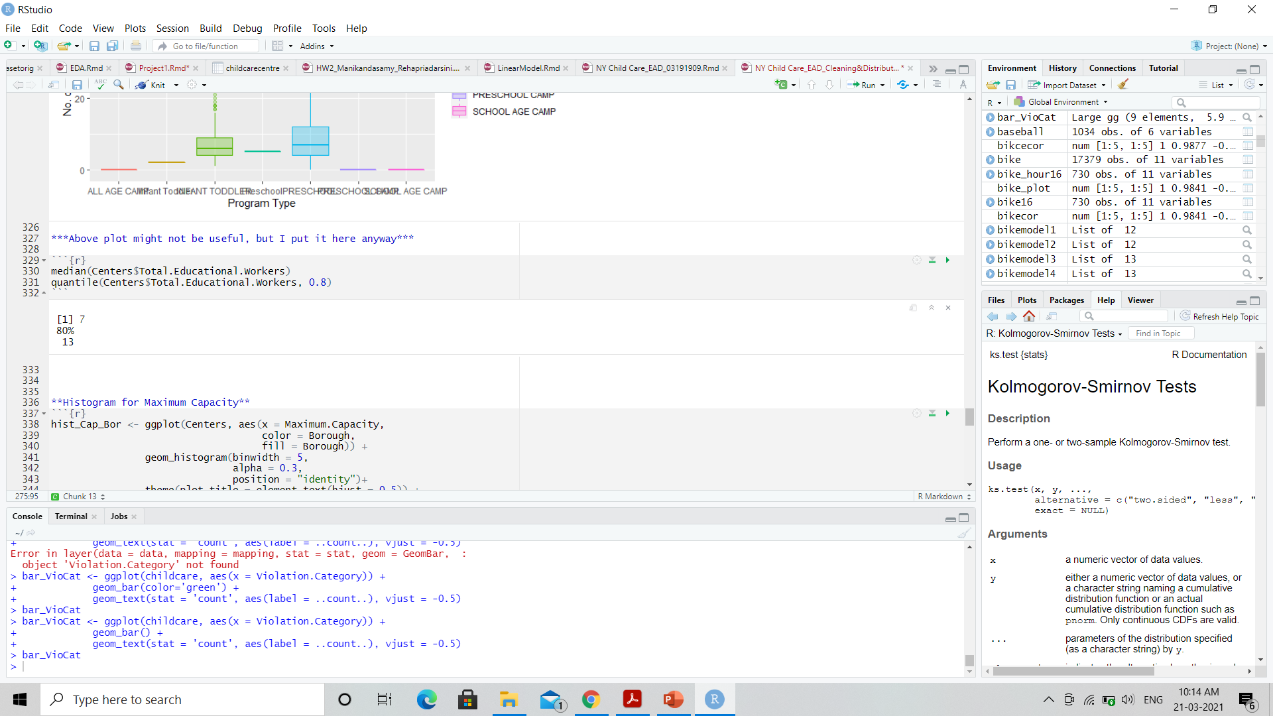
How many educational workers are distributed across each borough?

Slide 12
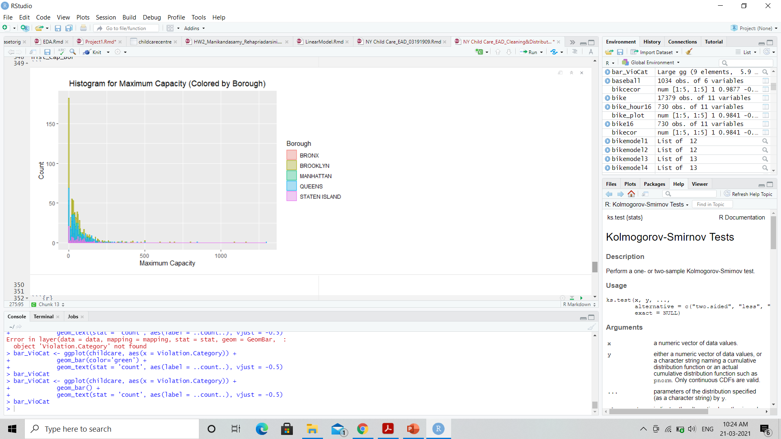
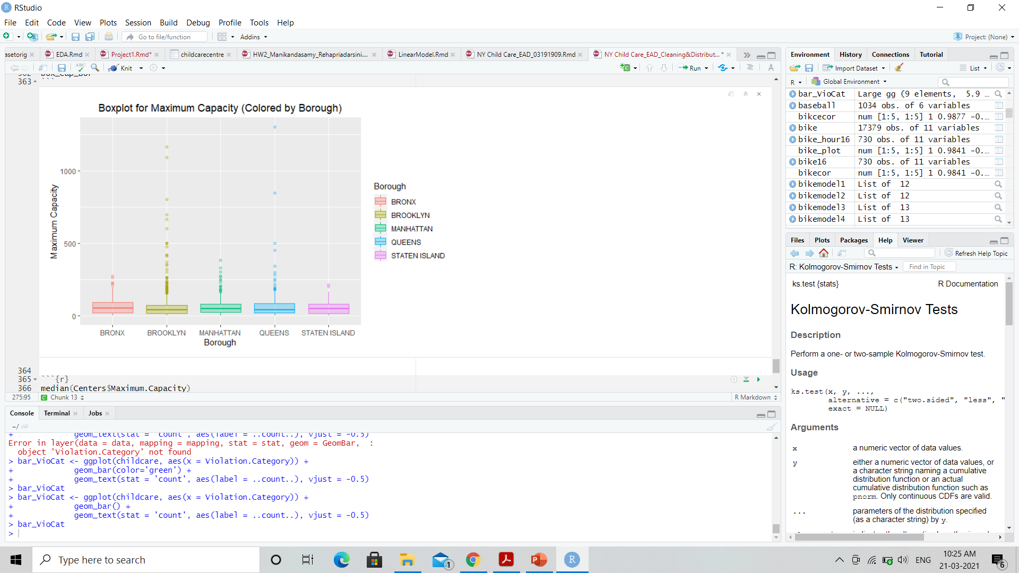
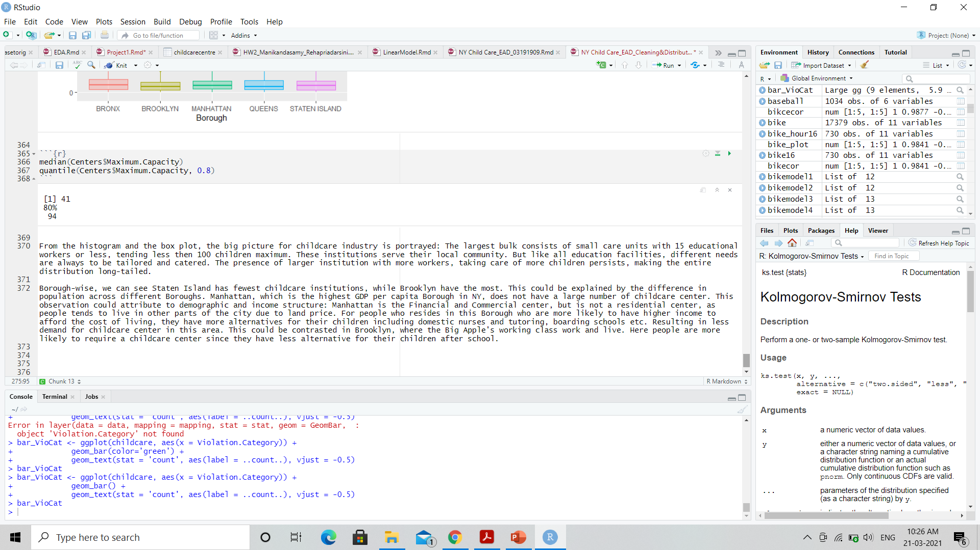
Maximum capacity of children in each borough

Slide 13
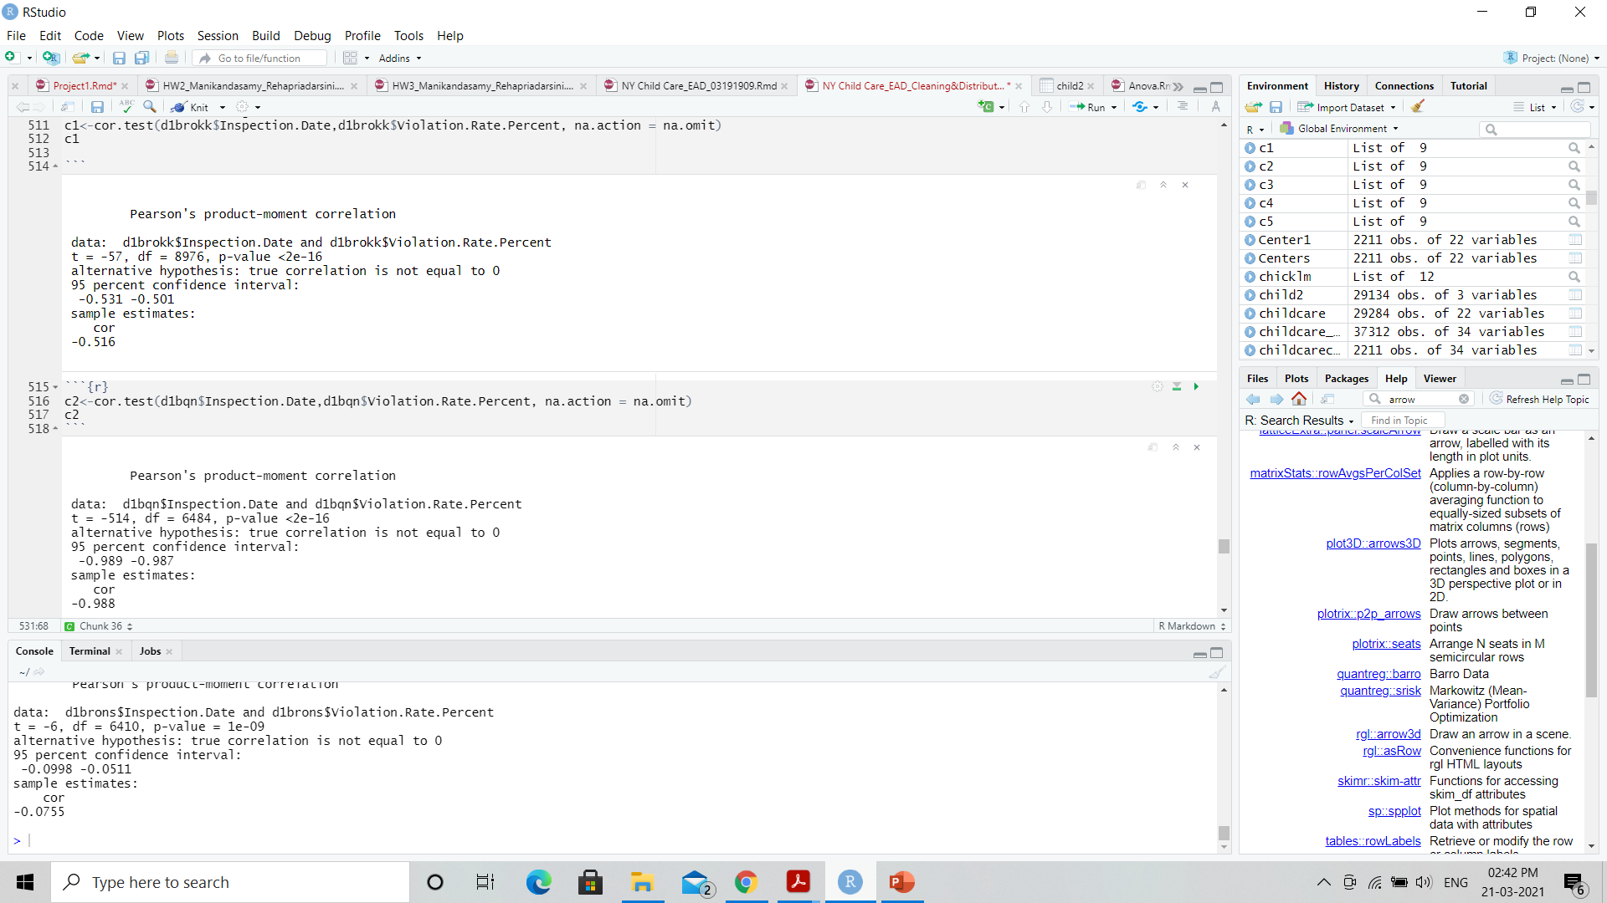
Correlation Test : Which borough has improved over the period (2018-2021)?
Cor.test()- Inspection date and Violation Rate (for Brooklyn)
Cor.test()- Inspection date and Violation Rate (for Queens)

Slide 14
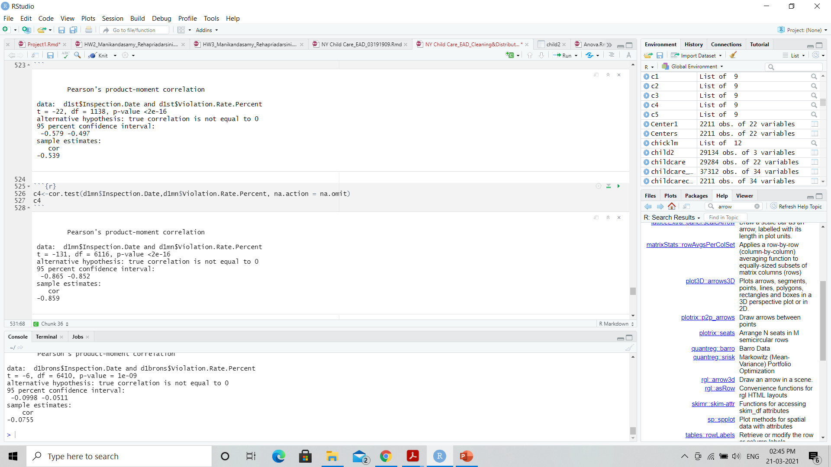
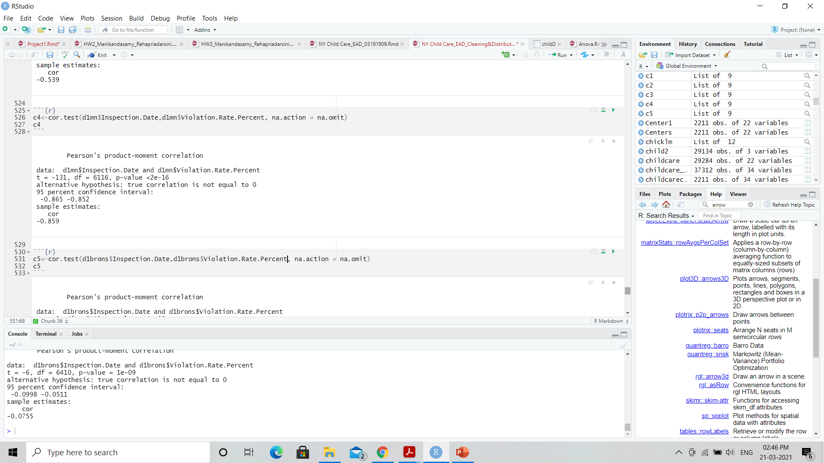
Cor.test()
Cor.test()- Inspection date and Violation Rate (for Staten Island)
Cor.test()- Inspection date and Violation Rate (for Manhattan)

Slide 15
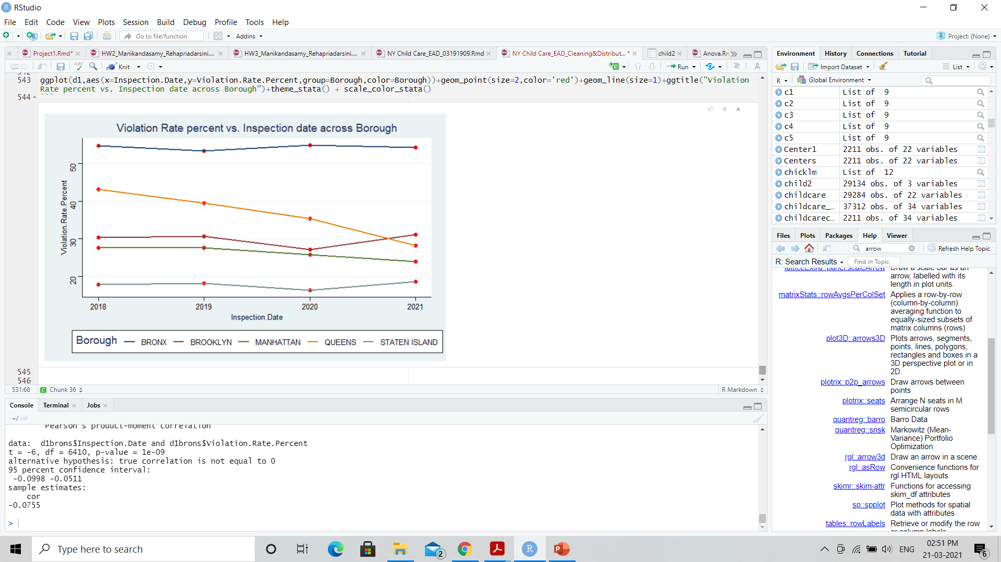
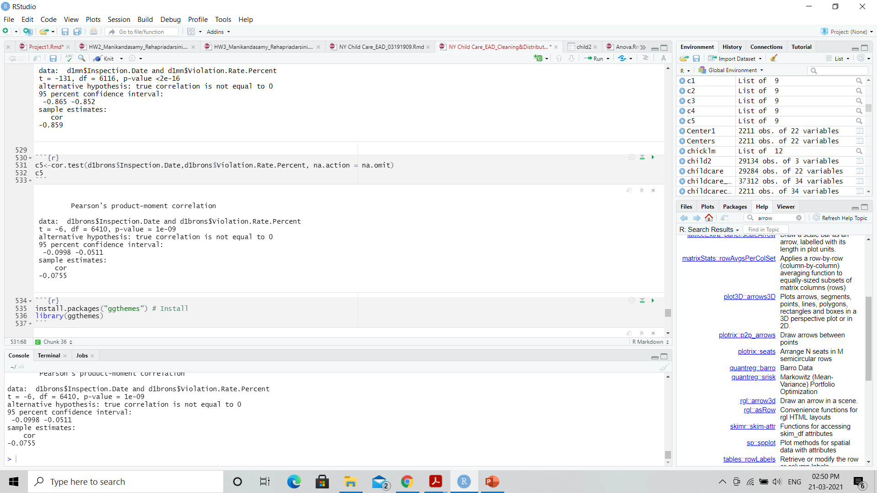
Cor.test()
Cor.test()- Inspection date and Violation Rate (for Bronx)

Slide 16



Before class begins
Do your best to arrive on time and be ready to learn each day.
Put away your jacket, backpack, and any other items you bring from home.
Have a seat, greet the classmates seated near you, and begin the activity listed on the board.
Prepare for a great day of learning!

Slide 17


Pencil sharpening
You may sharpen your pencil any time except for during whole-class instructions, activities, or lessons.
Mechanical pencils are also allowed!

Slide 18

Nurse visits, restroom, and drink breaks
If you need to use the restroom, get a drink, or see the nurse, please ask permission and then record the time you leave and return on the sheet posted on the classroom door.

Slide 19



Assignments
Using your class time wisely will decrease the amount of work you need to complete at home.
Please record your first and last name on all of your assignments.
Completed assignments should be turned in to the tray on the table in the front of the room.
Assignments will be graded and returned to you each Friday.

Slide 20
Lining up for recess, lunch, and other activities
I will invite one group at a time to line up facing the classroom door.
01
Please be respectful and represent our class in a positive way.
02
The first person in line may hold the door for the rest of the class, and the last person in line may turn off the classroom light.
03

Slide 21




How and when to contact me?
I want you to have a great and successful year!
You may visit with me about questions or concerns any time we are not in the middle of direct instruction, or I am not helping other students.
You may email me if necessary, and I will respond when I am able.
I am available for extra help before or after school. When possible, please let me know in advance so I can plan accordingly.

Slide 22

When is the appropriate time to have a positive attitude and be respectful?
ALWAYS! Do your best to be respectful and have a positive attitude each day. We are going to have a fantastic year!

Slide 23
Customize this Template
Template Editing Instructions and Feedback

